Slide 1

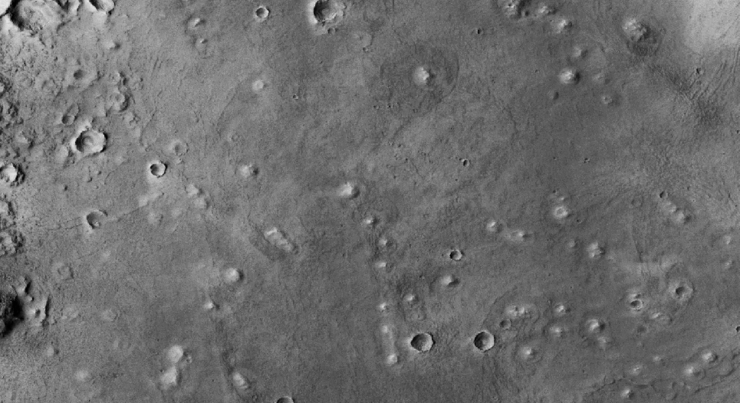



Mapping Mounds in Utopia Planitia to Investigate the Origin of Martian Volcanic Features
Greta Freeman, Northern Arizona University
Chris Okubo, USGS Astrogeology Science Center
Arizona Space Grant Symposium April 20, 2024

Slide 2
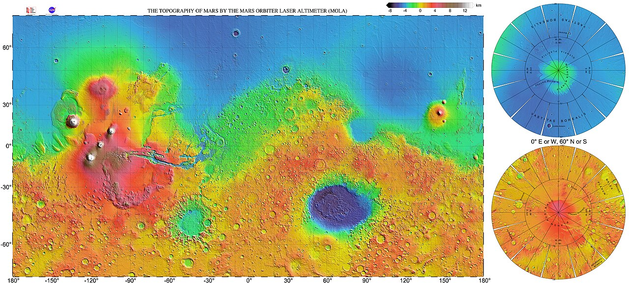
Background
Where is Utopia Planitia?
What is significant about this region?
Project goal:
Utopia Planitia
To get a statistical idea of the elevation distribution of mound proportions and to characterize the spatial relationship between volcanic features with the surrounding geologic units
Fig. 1: Global topographic map of Mars (NASA)

Slide 3
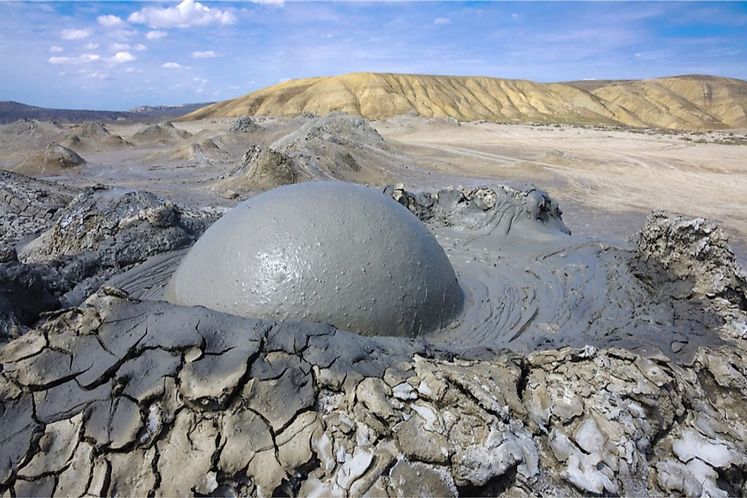
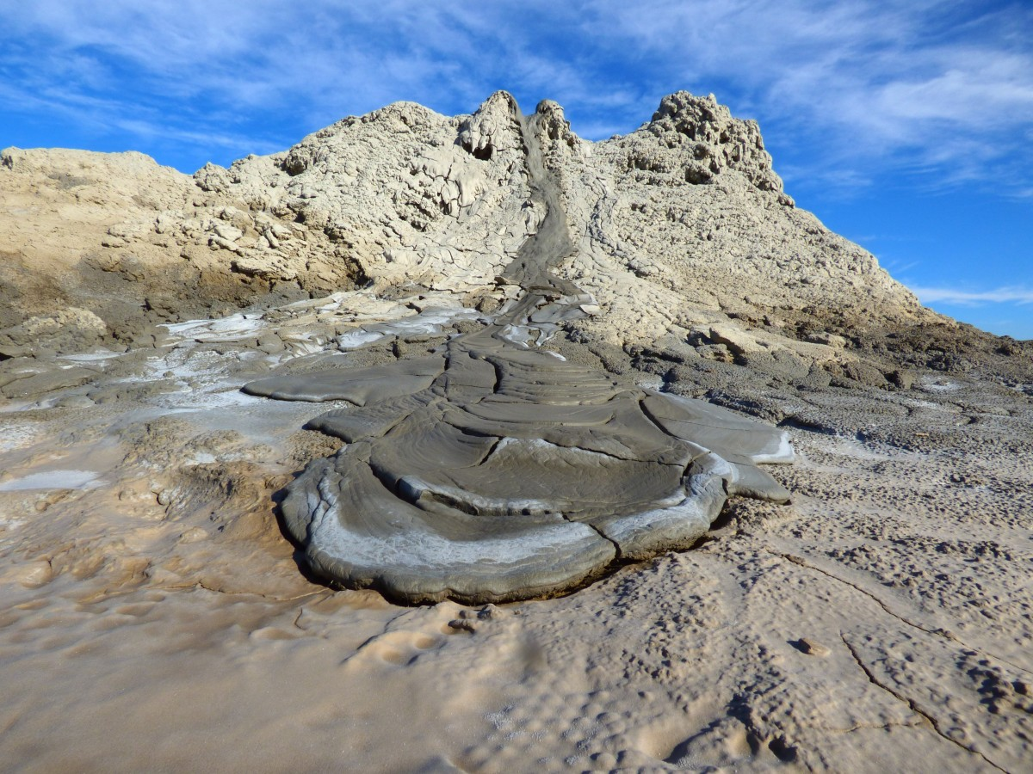
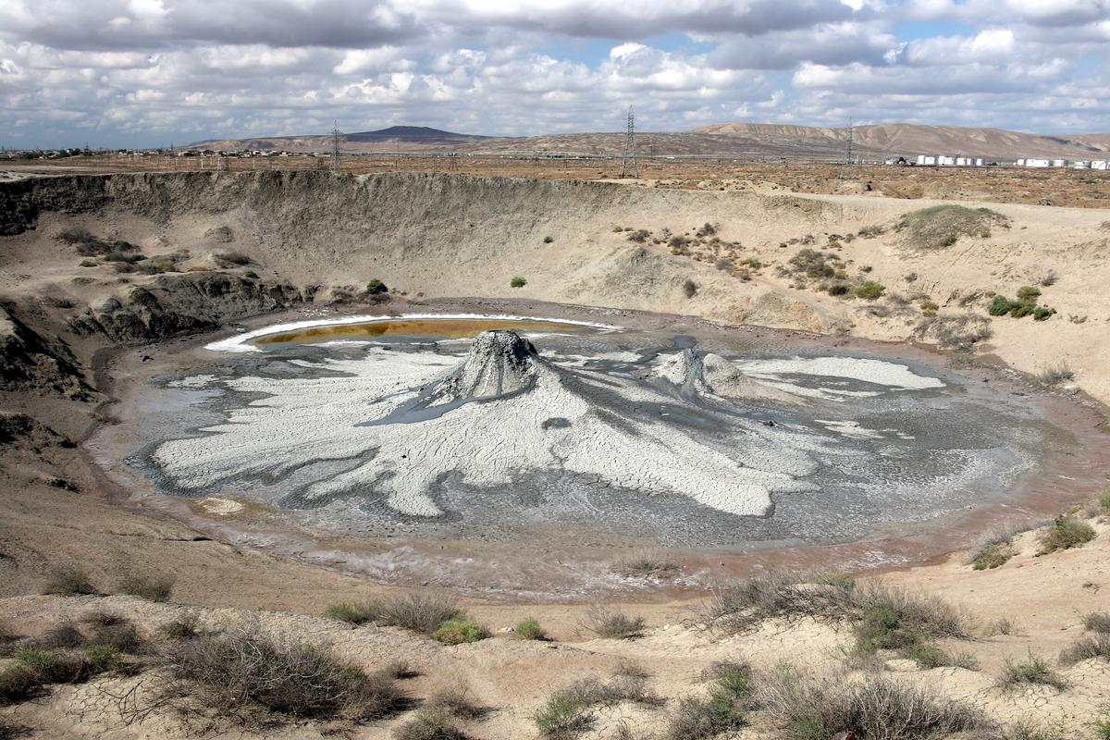
Terrestrial Mud Volcano Examples
(Salton Sea mud volcanoes)
(Karuga, 2017)

Slide 4
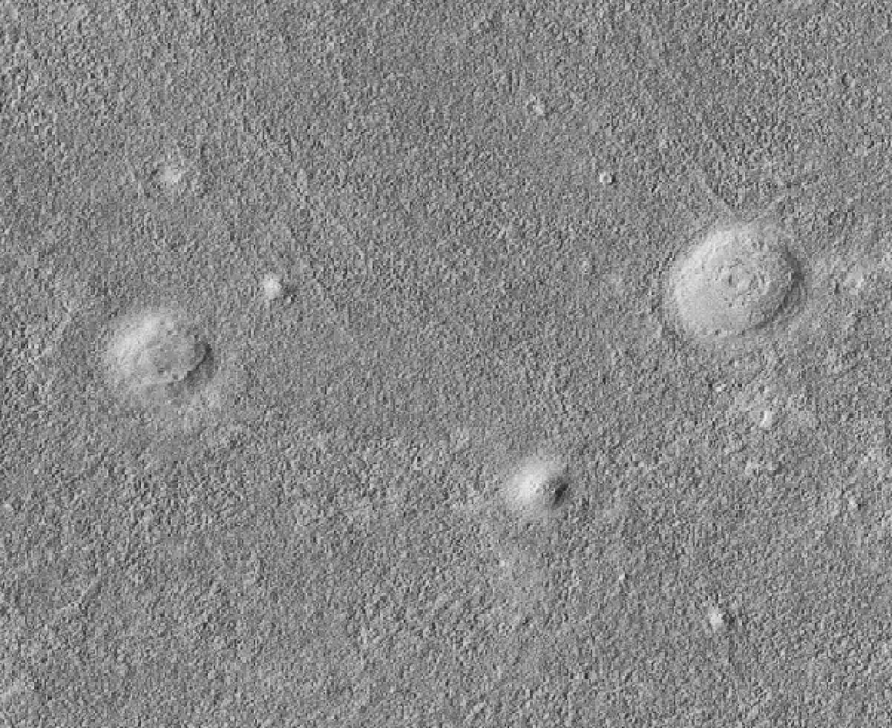
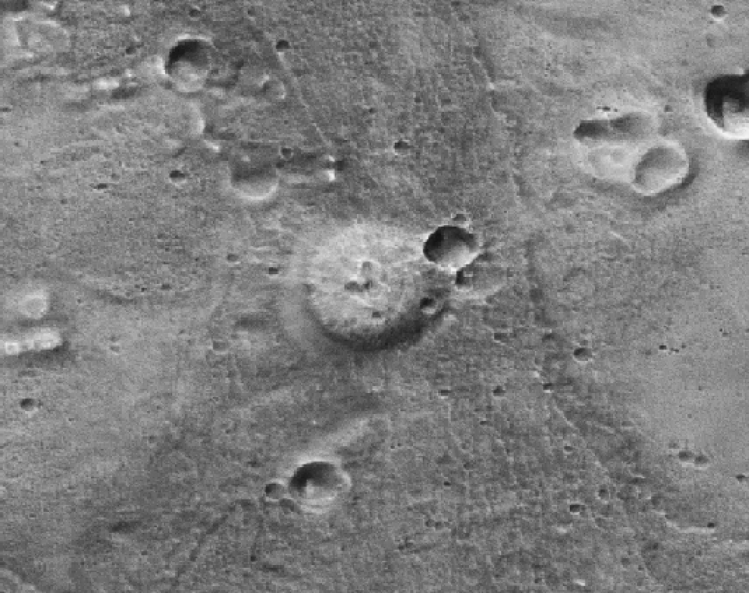
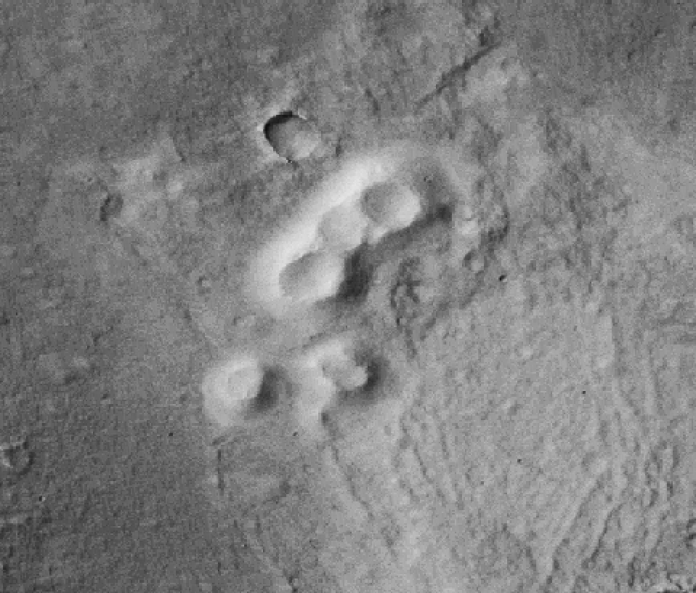
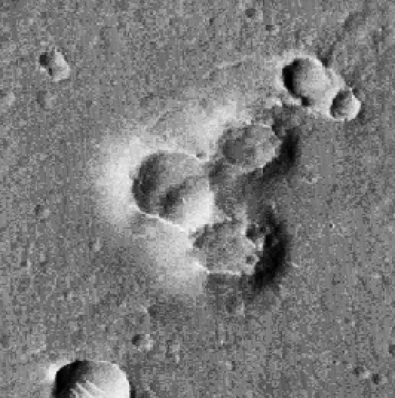
Mound Subcategories
Smooth Mound
Pitted Mound
Cratered Mound
Pitted and Cratered Mound
0.5 km
0.5 km
0.5 km
0.5 km
33.951°N, 90.912°E
31.579°N, 95.312°E
29.124°N, 90.626°E
27.887°N, 99.616°E

Slide 5
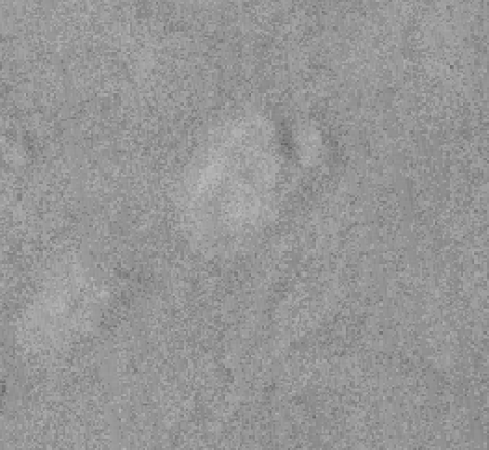
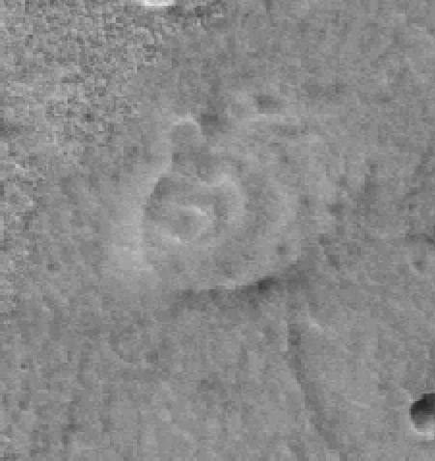
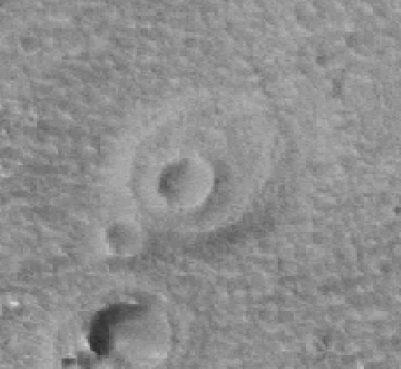
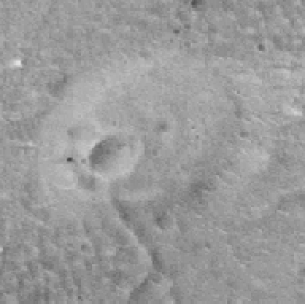
Shield Subcategories
Smooth Shield
Cratered Shield
Pitted and Cratered Shield
Pitted Shield
0.5 km
0.5 km
0.5 km
0.5 km
30.938°N, 89.145°E
30.697°N, 95.74°E
30.708°N, 96.077°E
30.77°N, 96.196°E
* only 4 were identified but it is unclear if they are other eroded mounds

Slide 6
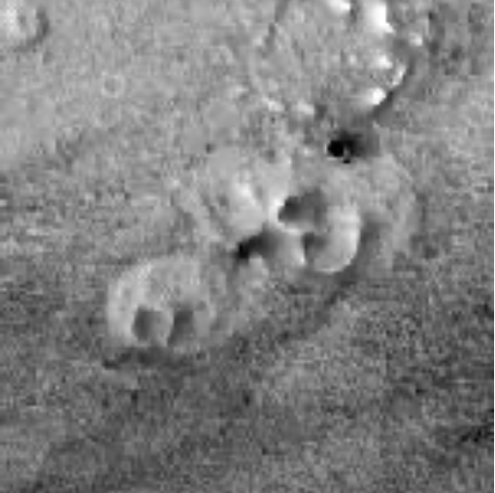
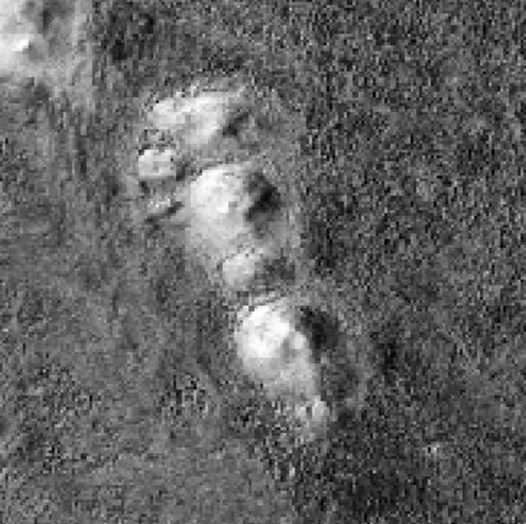
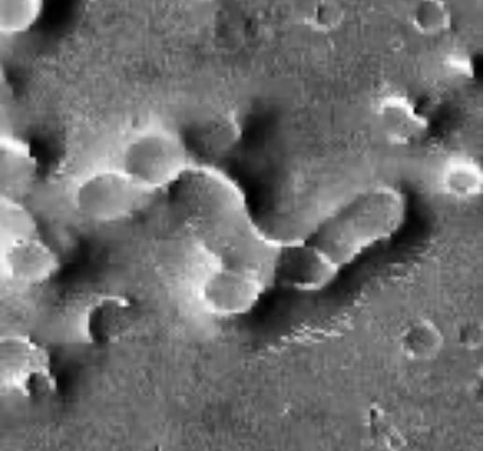
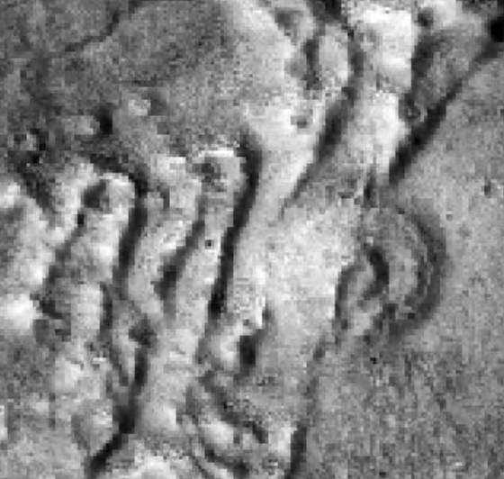
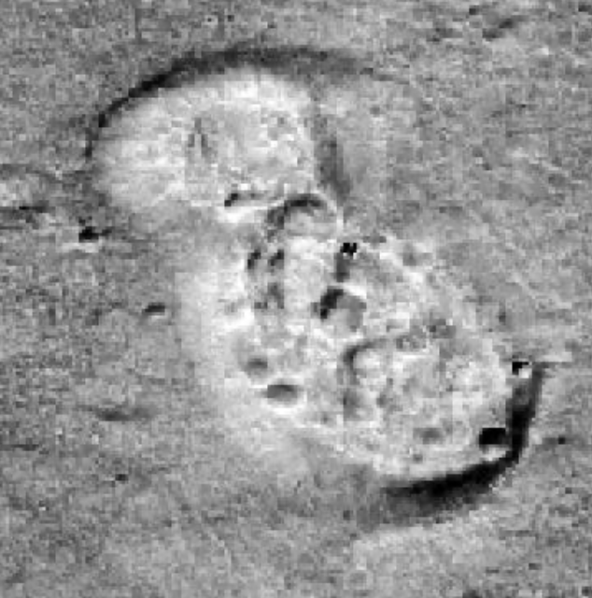
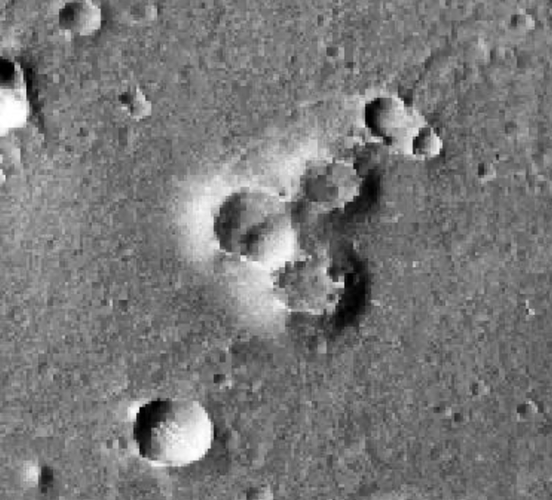
Complex Subcategories
Mounds that overlap are classified as mound complexes
Undivided Shield Complex
Smooth Mound Complex
Cratered Mound Complex
0.5 km
0.5 km
0.5 km
Diverse Mound Complex
Pitted and Cratered Mound Complex
Pitted Mound Complex
0.5 km
0.5 km
0.5 km

Slide 7
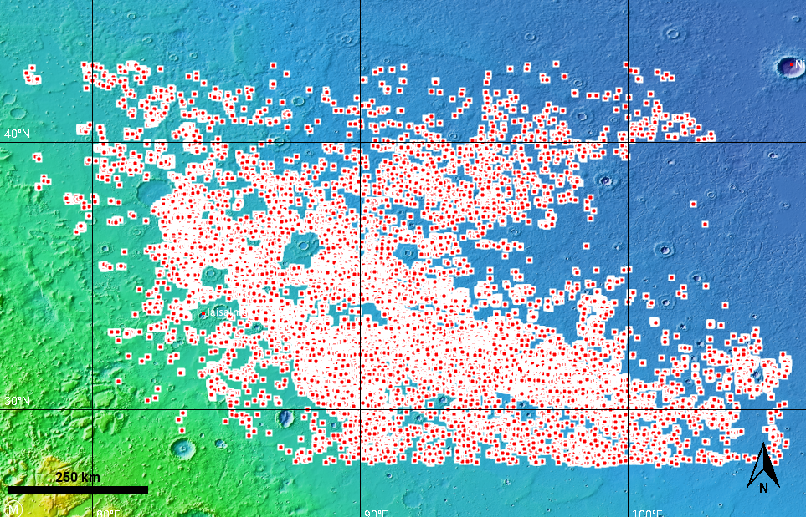
Methods
JMARS
  Used CTX Global Mosaic v1 (Murray Lab) Layer to record mound locations
    Mosaic images derived from MRO
  35,000 data points mapped
ArcGIS Pro
  Attributed mapped points to geologic units and elevations
Fig. 2: Topographic map of Utopia Planitia with mapped mounds

Slide 8
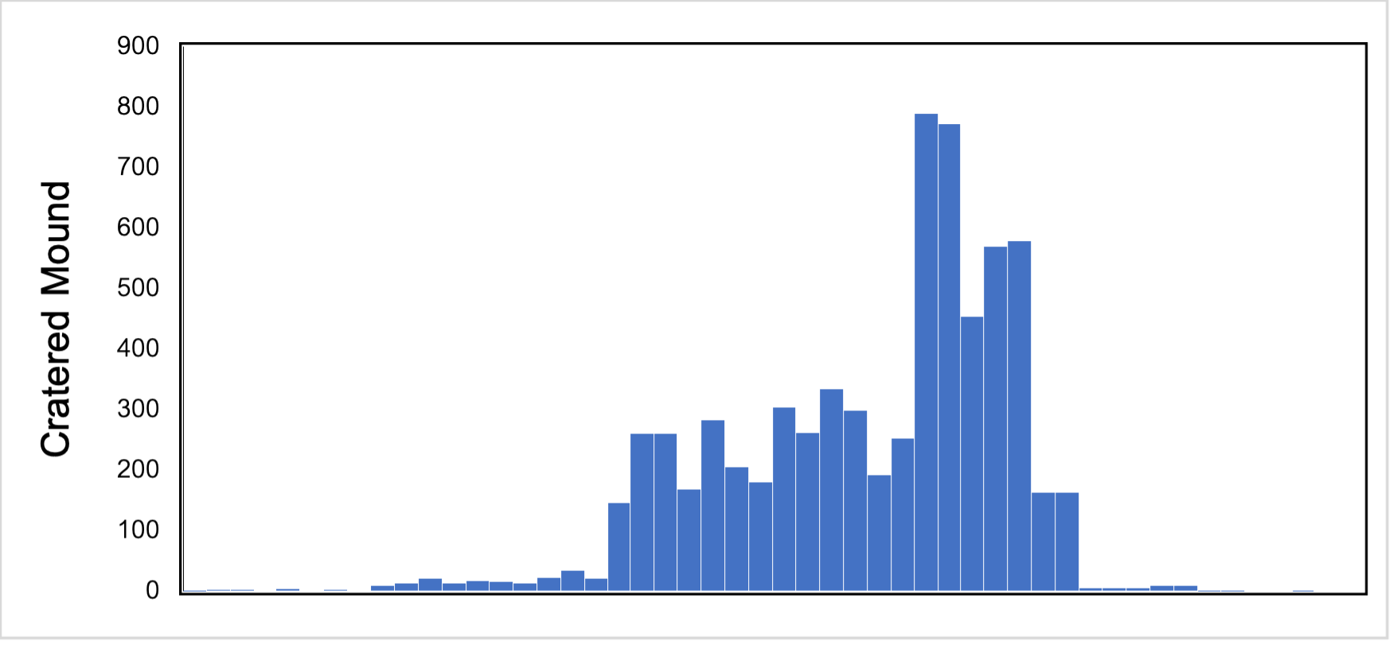
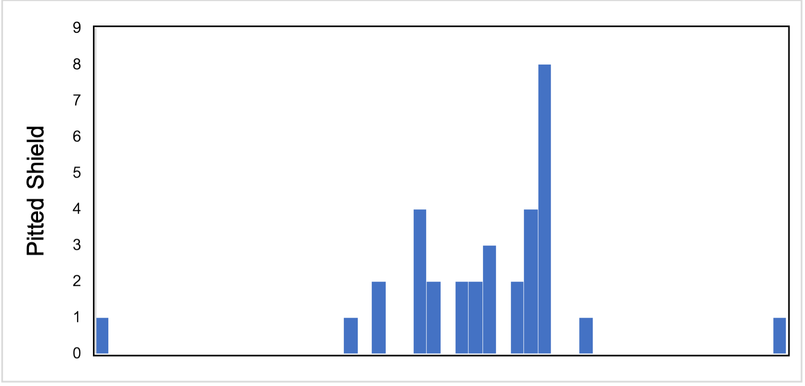
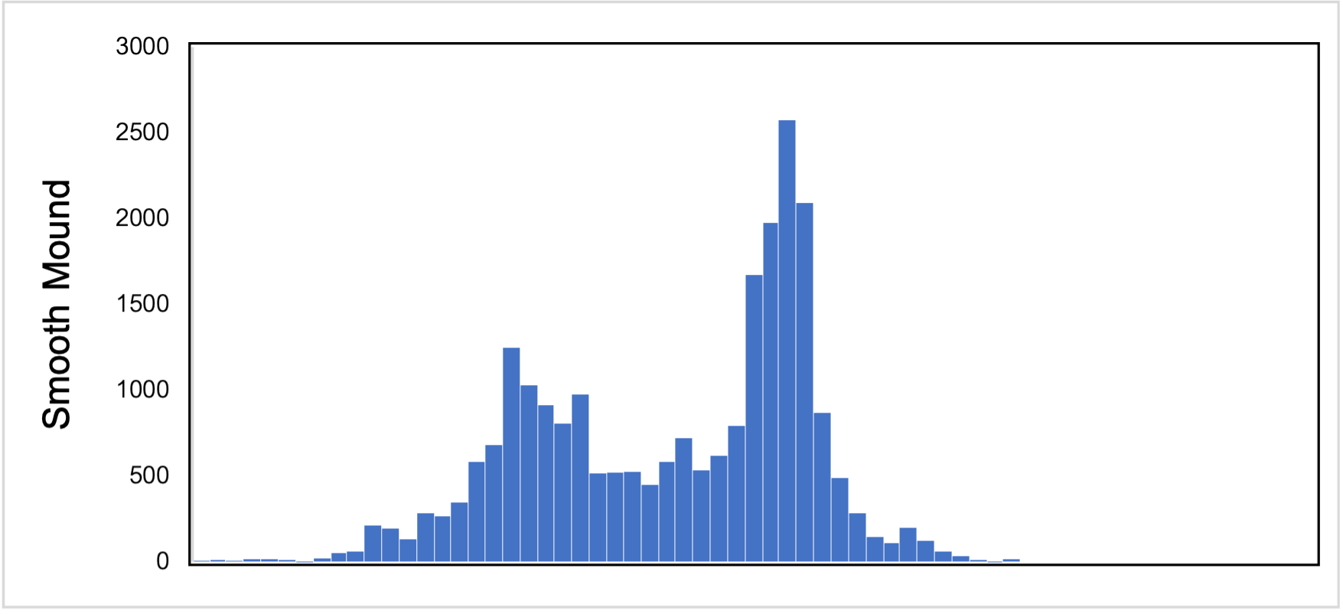
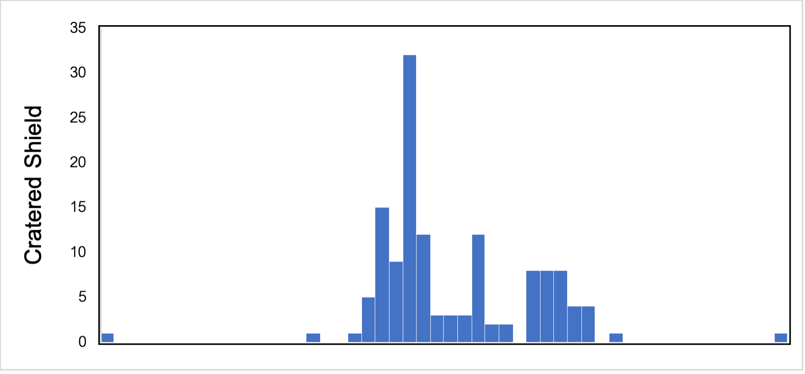
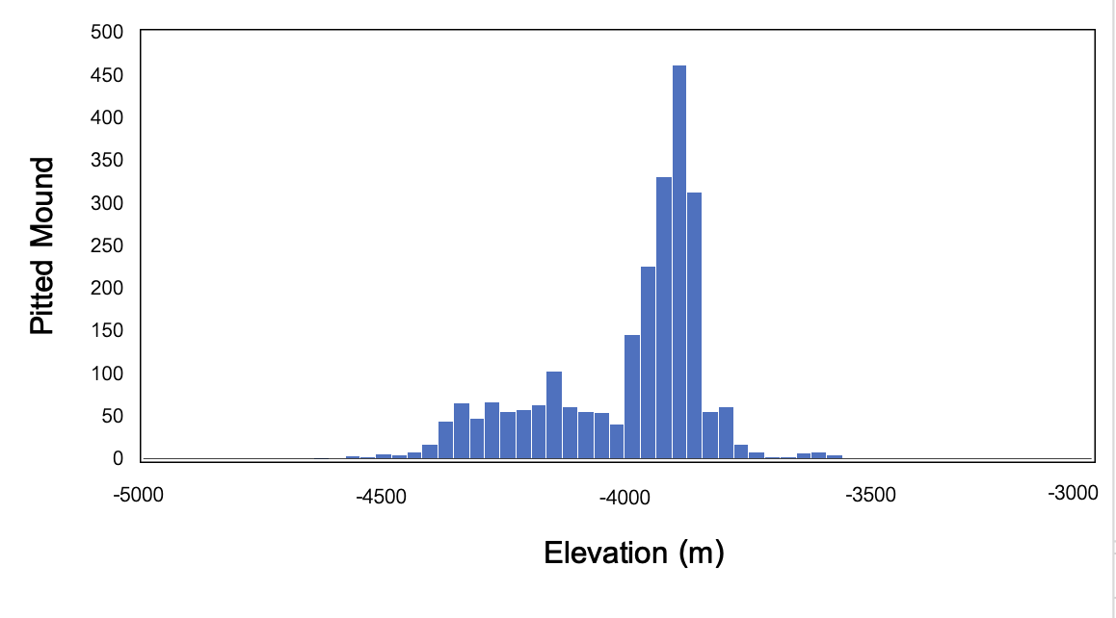
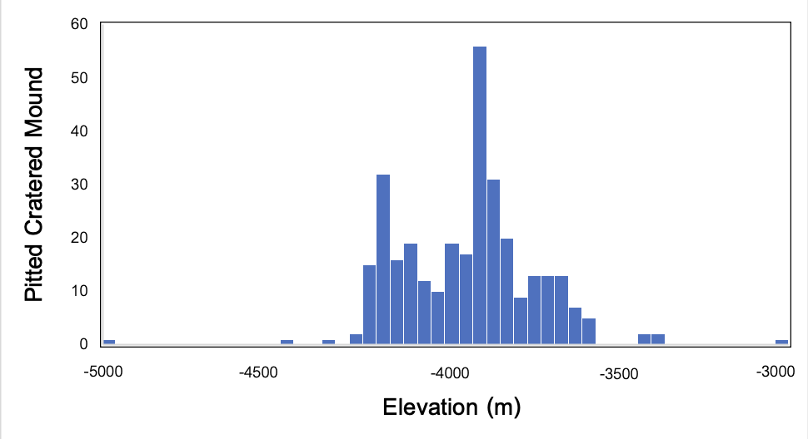
Results

Slide 9
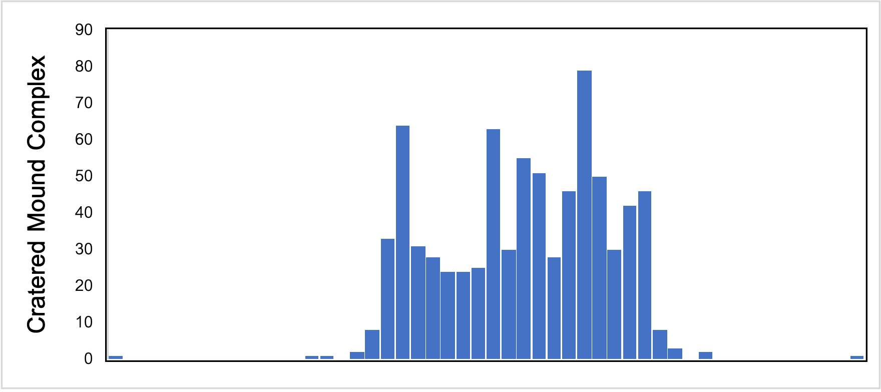
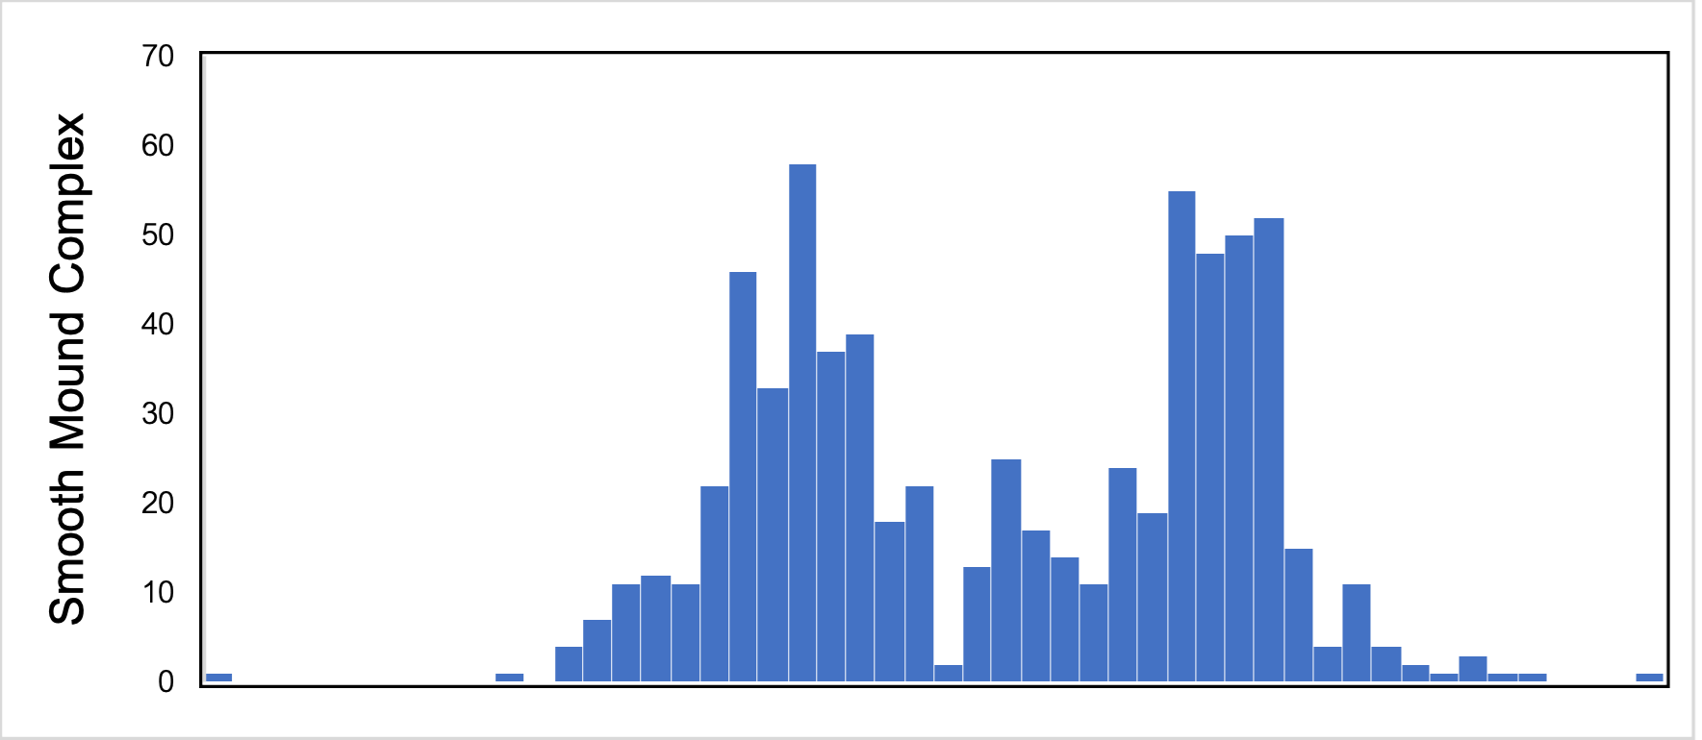
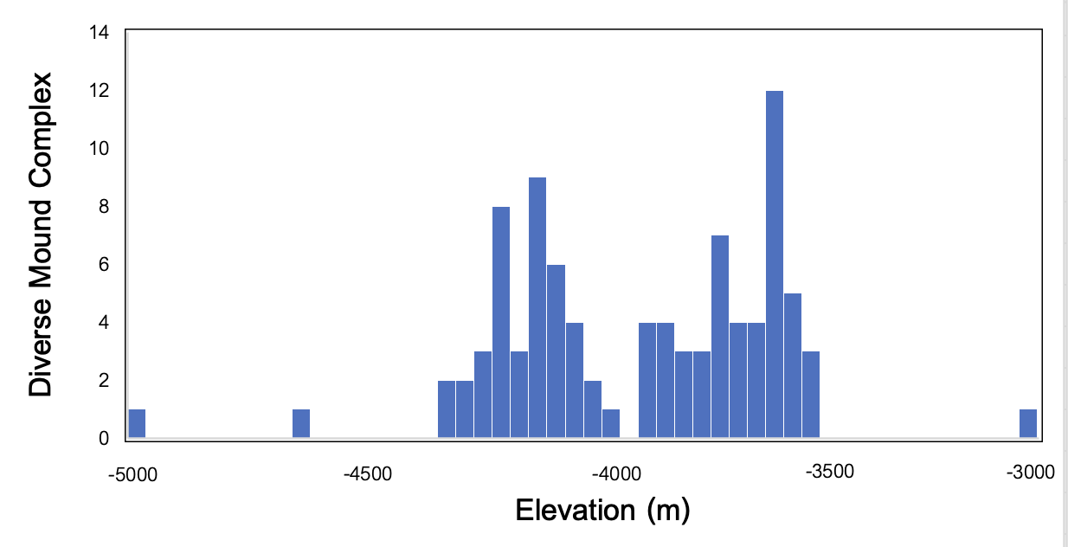
Results cont.
Appears to concentrated around -4000 m
Most common geologic units:
  Hesperian
    Age: 3.6 to 3.2 Ga
    Volcanic activity and a wetter climate
  Middle Amazonian
    Age: 3.2 to 2 Ga
    Cold, arid climate transition

Slide 10
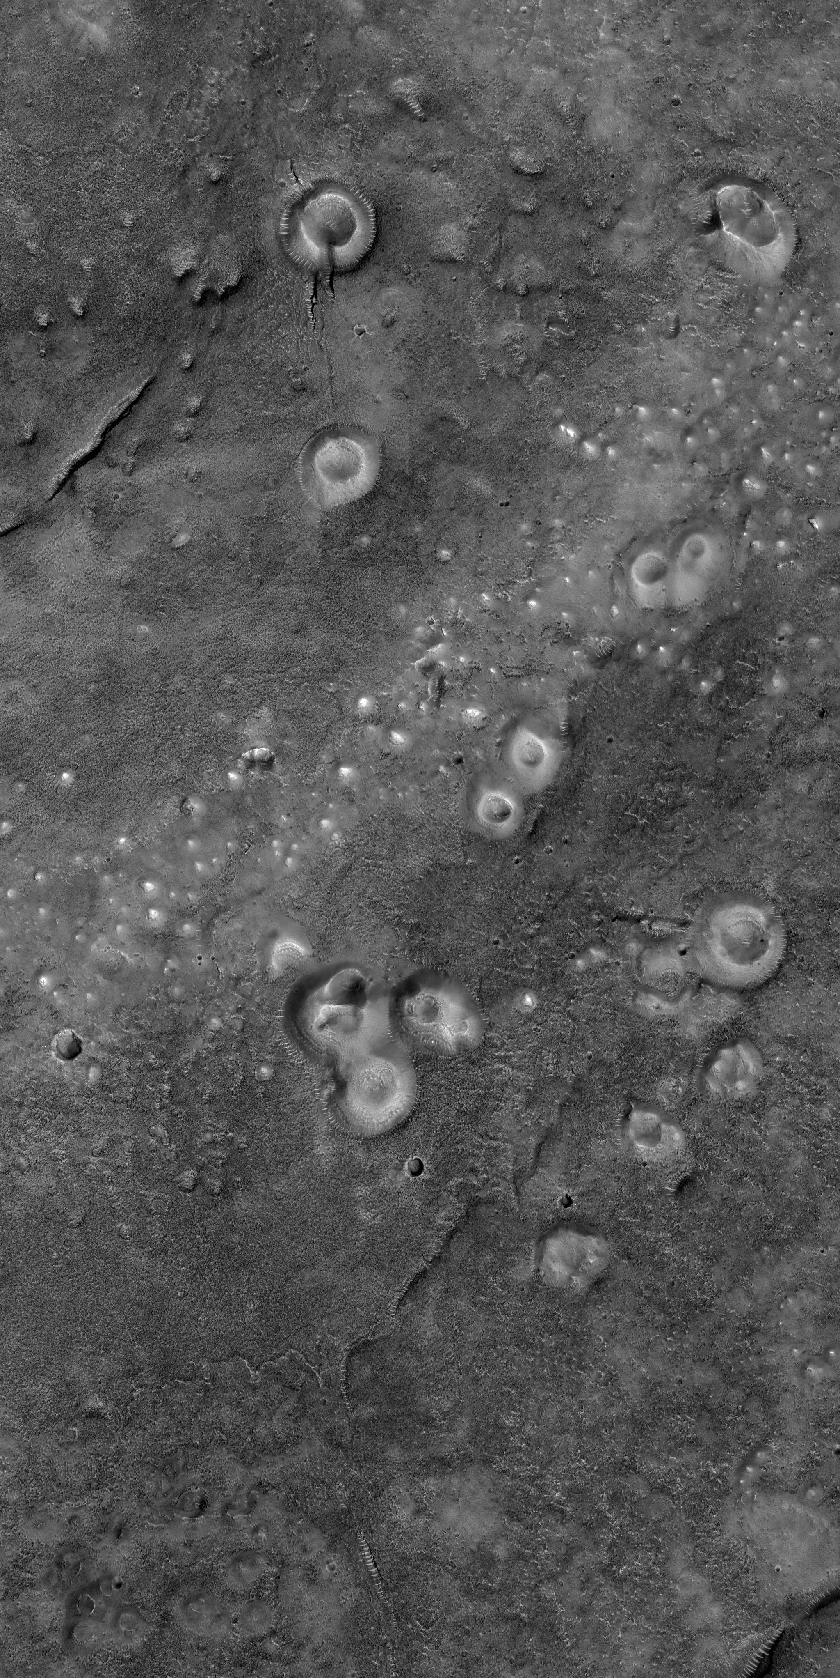
Conclusion
Origin is still unknown
Mound subcategories vary with elevation
Distribution along geologic units suggest a relationship between the subsurface history and current mound formations
?
Fig.3: HiRISE image of possible mud volcanos on Mars (PSP_008548_2205) )

Slide 11
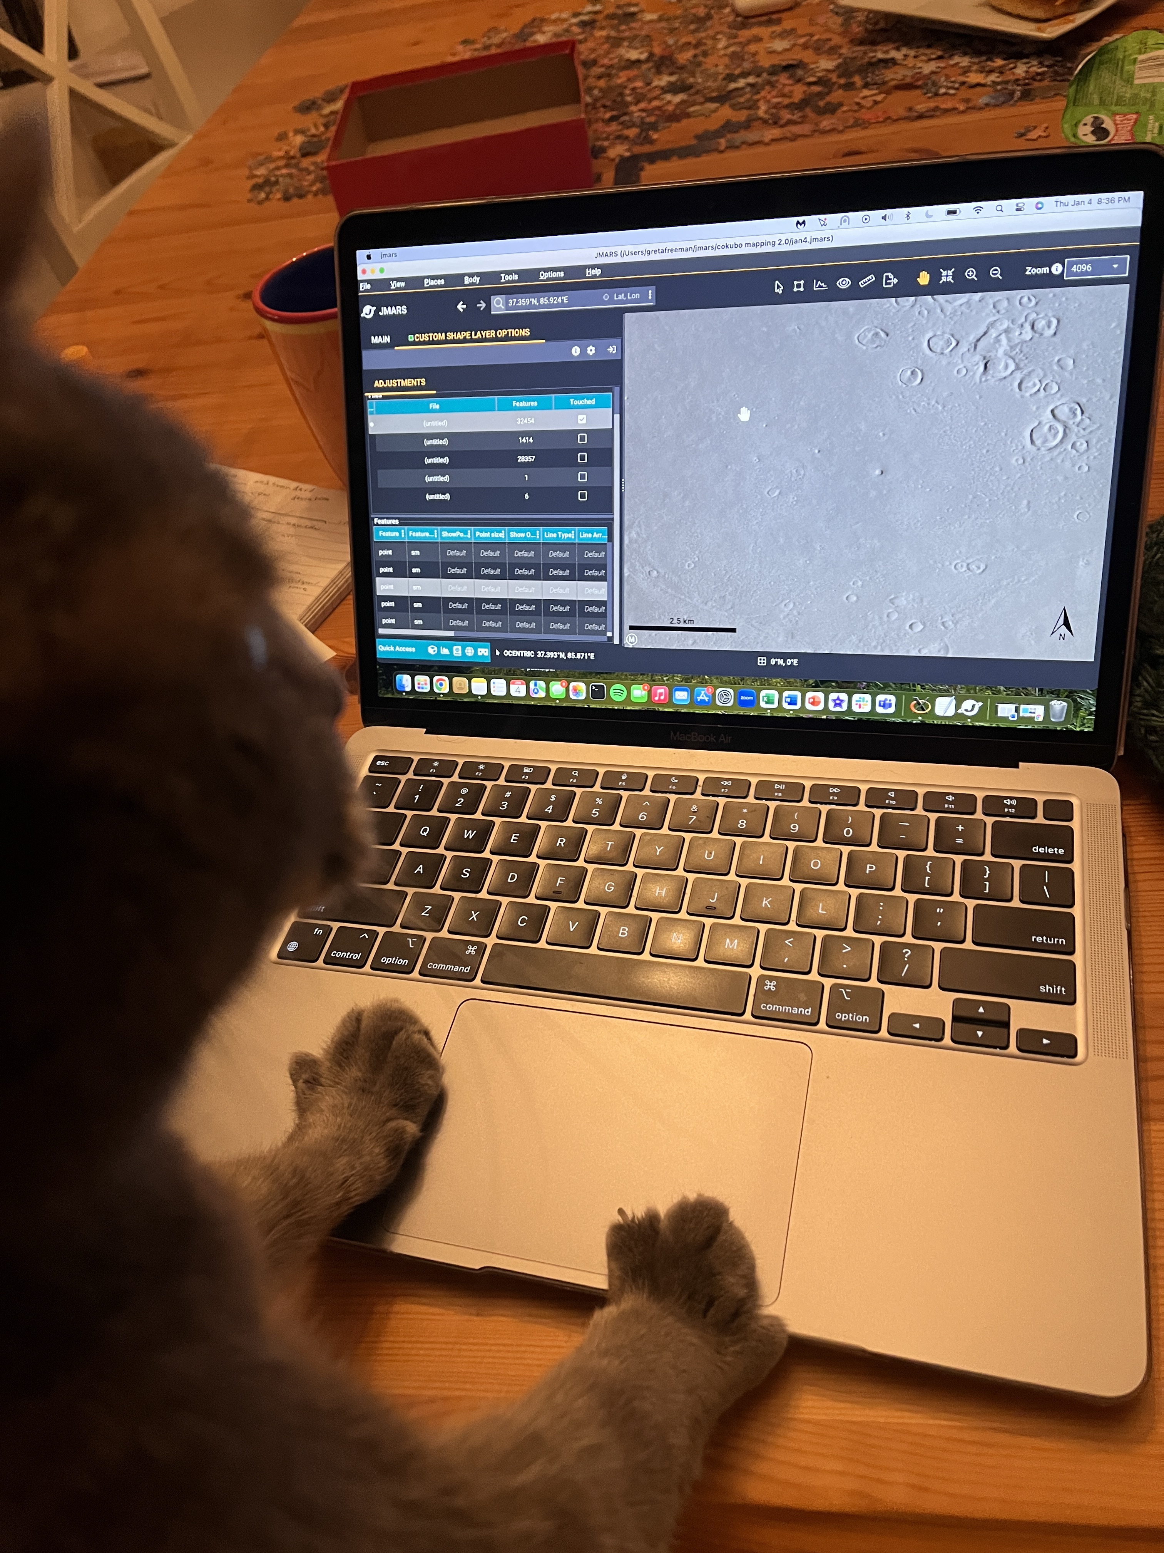
Thank You
I’d like to thank the following people who have advised me and supported my research goals throughout this project:
Chris Okubo
Holly Buban
Paloma Davidson
Fig. 4: My cat, Ivan, helping map mound locations using JMARS over winter break

Slide 12
References
NASA. (n.d.). Image gallery. NASA. https://attic.gsfc.nasa.gov/mola/images.html
Karuga, J. (2017, September 14). What is a mud volcano?. WorldAtlas. https://www.worldatlas.com/articles/what-is-a-mud-volcano.html
Salton Sea mud volcanoes near Niland, CA. TheHotFlashPacker.com. (2019, May 30). https://thehotflashpacker.com/salton-sea-mud-volcanoes/
Mystery mounds in southern Acidalia Planitia (PSP_008548_2205). HiRISE. (n.d.). https://hirise.lpl.arizona.edu/PSP_008548_2205

